Slide 1
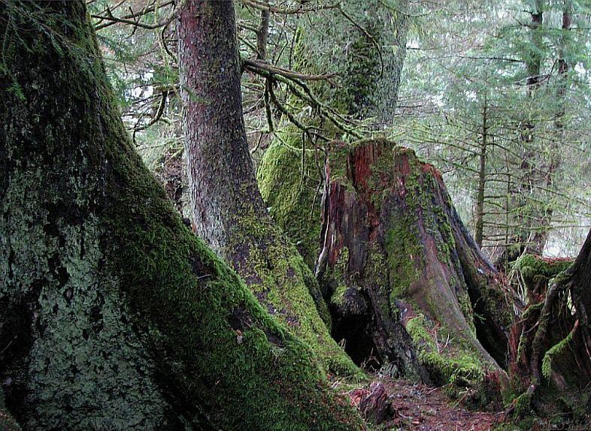
Biodiversity
Dr Maya Mahajan

Slide 2
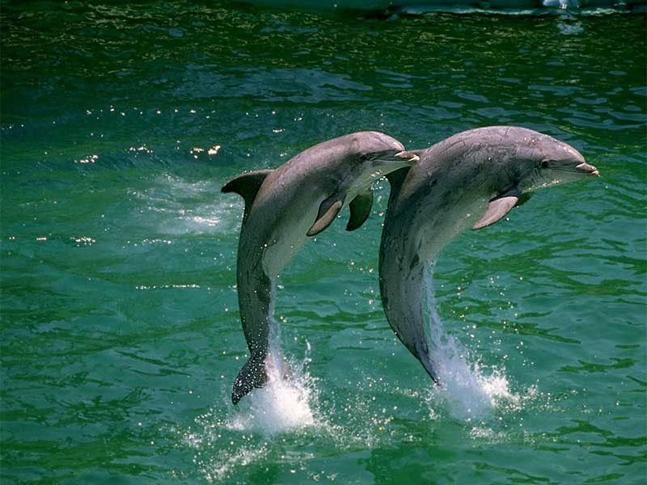
Environment and Ecology
What is Environment?
Surroundings: Natural and man made
What is Ecology?
The study of the interactions between organisms and their environment

Slide 3
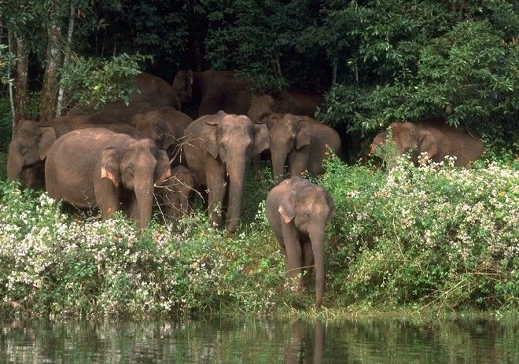
Ecosystem
Biotic factors: Living
Abiotic factors: Non living
Biotic factor, Abiotic factor and their interaction with one another

Slide 4
What is Biodiversity?
Bio-diversity means the variety of life on Earth.
the product of four billion years of evolution. .
"Biodiversity" was coined as a contraction of "biological diversity" in 1985. A symposium in 1986, and the follow-up book BioDiversity (Wilson 1986),

Slide 5
It is measured as the
Species Diversity
Genetic diversity, &
Variety of Ecosystems

Slide 6
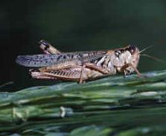
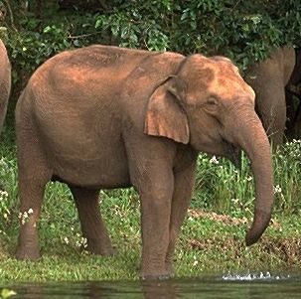
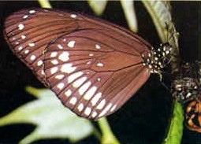
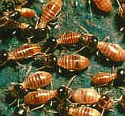
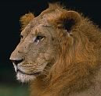
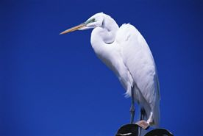
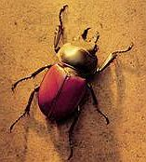
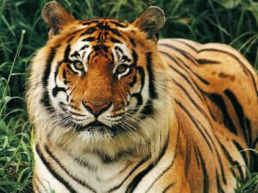
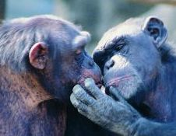
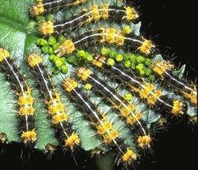

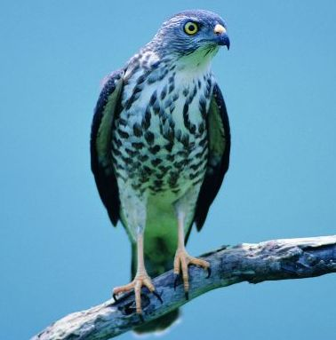

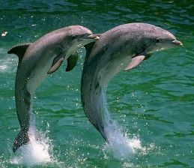
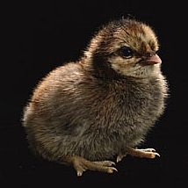
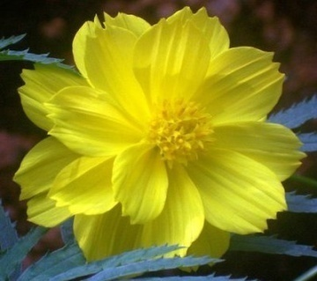
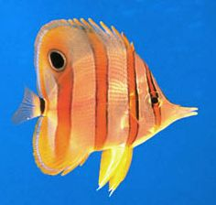
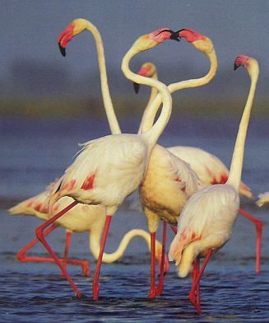
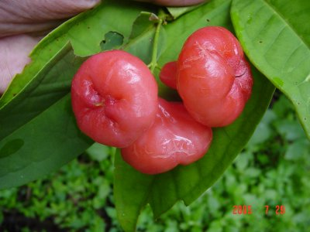
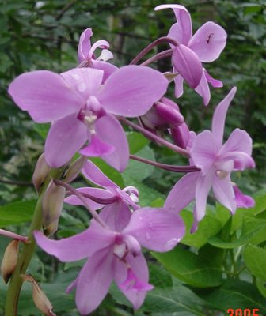
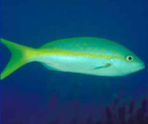
Species Diversity

Slide 7
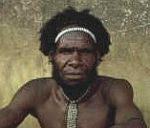



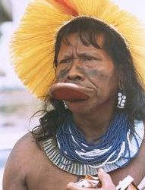
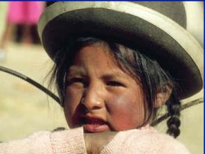


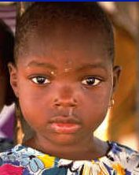
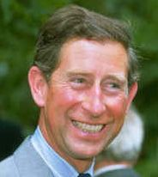

Genetic Diversity

Slide 8
Ecosystem Diversity
Terrestrial Ecosystem
Evergreen forest, Shola
Grass land
Dry/Moist deciduous forest
Alpine forest
Aquatic Ecosystem
River
Lake, Pond
Marine/Coastal Ecosystem
Mangrove Ecosystem, Coral Reef

Slide 9
Domesticated Diversity
Different crop varieties and livestock breeds
50,000 Varieties or Rice in India. Navadanya has identified over 150 sps of rice in Western Ghats
Warali tribes in Maharashtra grow different varieties of rice for different climatic conditions
India’s eight breeds of buffaloes represents the entire range of genetic diversity of the world

Slide 10
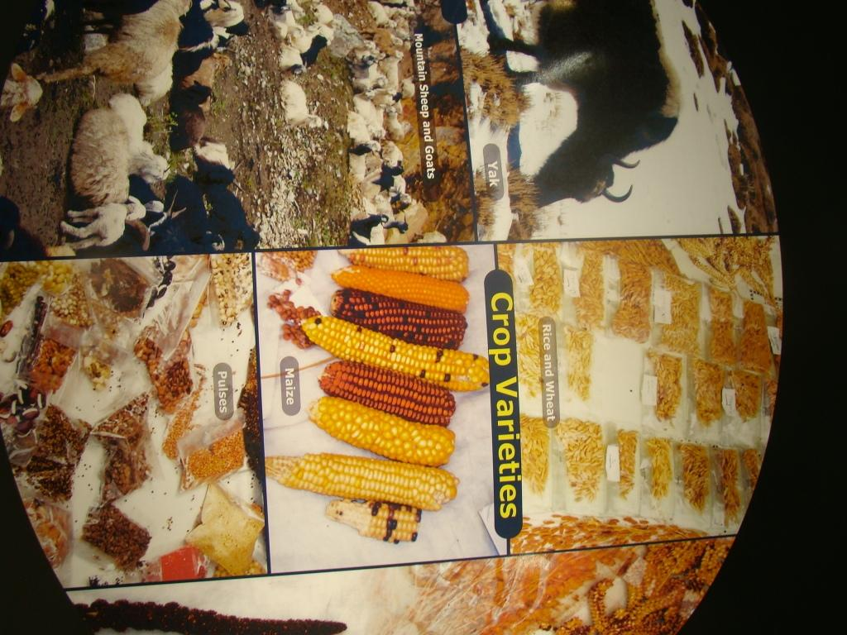

Slide 11
Estimation of Biodiversity
For empirical measurement—
2 criteria: Species richness & Species Evenness
Measurement Indices:
Species richness-only number of species.
Simpson index-number and evenness
Shannon index - species richness and number
Alpha diversity—no. of species within the ecosystem
Beta diversity is species diversity between ecosystems; Comparison
Gamma diversity is a measure of the overall diversity for different ecosystems within a region.

Slide 12
Biodiversity Global
No. of total species - ???? Not known
estimated total at about 10 million - 30 million
The number of described species 1.8 million;
Majority of unidentified species are microbes and insects
It has taken 4 billion years for this biodiversity to evolve,
We are rapidly destroying it. (6th Mass extinction- Man made)

Slide 13
India –one of the richest country in the world. Why?
8% of words biodiversity in just 2% of earths surface
Diverse ecosystems and climatic conditions
16 major forest types. Forest cover 21%
One of the 17 mega diversity countries in the world
Has Global biodiversity hot spots (North east , Western Ghats
Origin of 30,000 cultivated Plants
High endemicity (11058 species of plants are endemic)

Slide 14
Centre of Plant Biodiversity
At least 166 spp of crops and 320 species of wild relatives of cultivated crops are originated in India
(NY Vavilov-Russian Scientist)
Rice 50,000 varieties
Mango 1,000 varieties
Sorghum 5,000 varieties
Pepper: 500 Varieties
All the world’s buffalo breeds are found in India
All poultry breeds in India-Red Jungle fowl (Wild)
All cow breed originated from India-Zebu (wild)

Slide 15
India – biodiversity
45,500 plant species (17,527 flowering plants)
91,200 species of animals, including
57,000 insects (highest number)
4,000 molluscs,
2546 fish,
460 reptiles,
248 amphibians,
1232 birds and
397 mammals
20000 invertebrates

Slide 16
Endemic species in India
Species, whose distribution is confined to a particular region
At high risk of extinction
Endemism-rich areas: NE, NW, and E Himalayas, Western Ghats
44 mammals, 55 birds, 214 reptiles, 110 amphibians endemic to India
11,058 plants are endemic to India

Slide 17
Endemism in India
9% of fish
61% of amphibians
47% of reptiles
14% of birds
9% of mammals

Slide 18
Medicinal Plants
India has 8000 medicinal plants
Used in 50,000 herbal formulation
A major source of livelihood
Special Medicinal plant conservation areas have been established

Slide 19
Biodiversity Hotspots
in India: North East India and Western Ghats
Biodiversity hotspots criteria:
Regions that harbor a great diversity of endemic species and at the same time be significantly altered by human activities
Must support 1500 endemic species (0.1% of global)
Must have lost more than 70% of original habitat
25 world hotspots have 44% of all plant species and 35% of all vertebrates in 1.4% of land area

Slide 20
Western Ghats
One of the Biodiversity Hotspots in India
More than 5000 sps of Plants
Bird spp 508
Mammals 140 (Asian elephants 15,000)
Butterflies 334
Fishes 290
Reptiles and Amphibians 157 each
Diverse Ecosystems: Evergreen, Shola, Moist and dry deciduous forest, Scrub jungle etc

Slide 21
High Endemism in Western Ghats
Angiosperms 1500 (38%)
Butterflies 37 (11%)
Fishes 189 (65%)
Amphibians 135 (86%)
Reptiles 97 (62%)
Birds 19 (4%)
Mammals 18 (12%)

Slide 22
Western Ghat Conservation plan by Govt appointed committees
Western Ghat Conservation plan
Controversy Between
Madhav Gadgil report and Kasturirangan report (diluted )

Slide 23
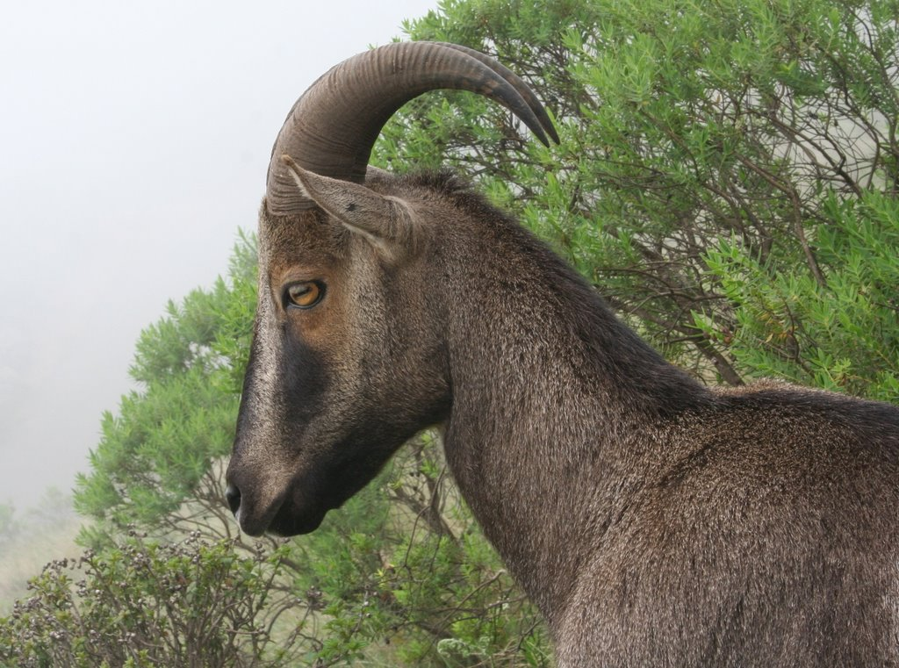
Nilgiri Thar- State animal of TN- Endangered
Static.panoramio.com

Slide 24
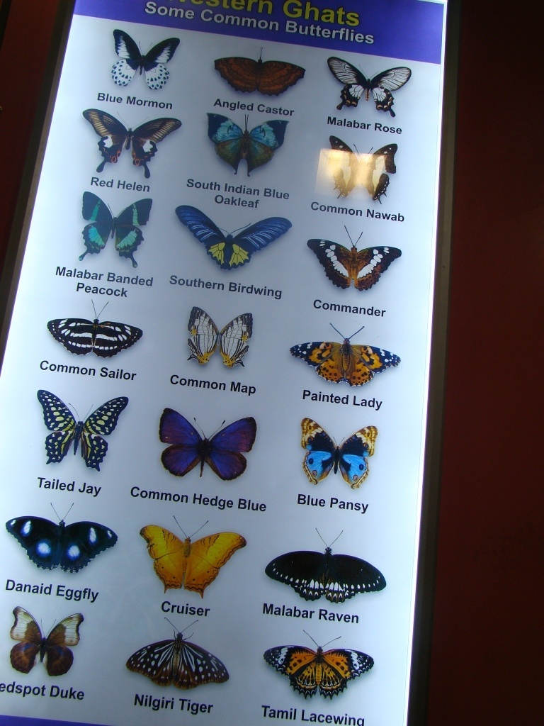
Butterflies
in Western
Ghats

Slide 25
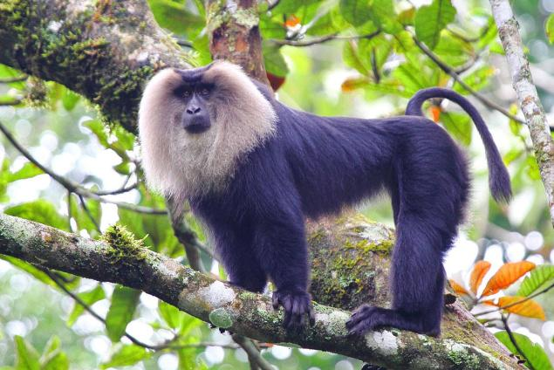
Nilgiri Biosphere Reserve
India’s first Biosphere Reserve (Siruvani Hills comes under NBR
Plant sps 3300
Birds 350 sps
Butterflies 300 sps
Reptiles and amphibians 80 sps
Mammals 100 sps
Endangered & Endemic to the area Lion Tailed Macaque, Nilgiri Thar

Slide 26
Why to Conserve ?
Ecological services:
Biodiversity provides us food security, water recharge, climate regulation.
Every species has its own role to play in the ecosystem
Every single species is an integral part of the vast chain of life
No chain is stronger than its weakest link !

Slide 27

Why to Conserve?
Economic Value:
Many species are used as food, fibre, medicine and resource for industrial products & energy. Values of many sp. (and even the species itself) are still unknown.
25% of all our drugs comes from plants
Around 119 pure chemical substances extracted from about 90 species of higher plants are also used in allopathic
Vinca to treat Hodgkins disease and cancer
Sarpagandha traditionally used for snake bite, dysentery, nervous disorder, fever, Reserpine, an extract from the plant is now the principal source of material for traquilizers medicine.

Slide 28
Ethical Value
Ethical value:
Every one has a right to live on this planet

Slide 29
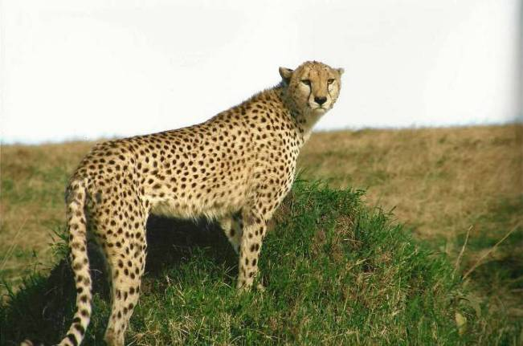
Aesthetic Value:.
Each species adds to the richness and beauty of life on the Earth.
Ones a species becomes extinct, its gone for ever
Picture by Amita Datta

Slide 30
Every single day ….
We are losing
300 km2 of rainforest, (1 acre / second)
40 to 100 species
Already lost 1 million species,
Natural rate of extinction - 1species/ year,
The present rate is 1species/hour (10,000 times higher)
Tonight the Earth will be a little hotter, its waters more acidic

Slide 31
Living Planet Index 2014
WWF’S(World Wide Fund) Living Planet Report is a biennial publication that documents the state of the planet- the changing state of the biodiversity, ecosystems and humanity’s demand on natural resources.
Living Planet Index (LPI) 2014, measures more than 10,000 representative populations of mammals, birds, reptiles, amphibians and fish (has declined by 52 per cent since 1970.)
http://wwf.panda.org/about_our_earth/all_publications/living_planet_report/
.

Slide 32
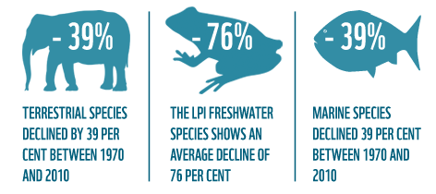
Living planet report 2014-WWF

Slide 33
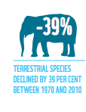
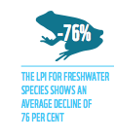
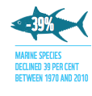
The loss of habitat– particularly for agriculture, urban development and energy production – continues to be a major threat, compounded by hunting.
The main threats to freshwater species are habitat loss, pollution and invasive species. Changes to water levels and freshwater system connectivity
The steepest declines can be seen in the tropics and the Southern Ocean – species in decline include marine turtles, many sharks, and large migratory seabirds

Slide 34
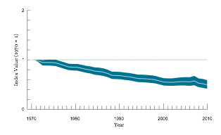
THE LIVING PLANET INDEX 2014
Biodiversity is declining in both temperate and tropical regions, but the decline is greater in the tropics.
Habitat loss & degradation, and exploitation through hunting and fishing, are the primary causes of decline.
Climate change is the next most common primary threat, and is likely to put more pressure on populations in the future

Slide 35
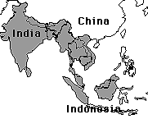
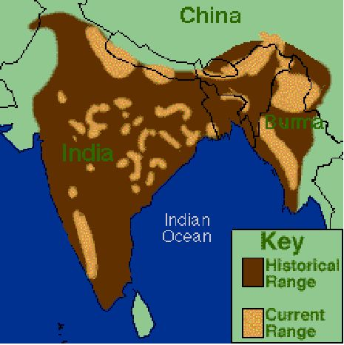
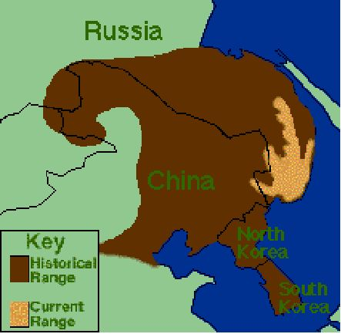
Shrinking ranges
Asian Elephant
Bengal Tiger
Siberian Tiger

Slide 36
Loss of Biodiversity in India
The Cheetah -spotted big cat is extinct in India
Pink Headed duck-Extinct
Jerdon’s courser rediscovered in 1985
Loktak lake-Manipur Brow antler deer (Dancing deer) Endangered due to habitat loss
10% Plants, 20% Mammals, 5 % Birds are threatened.
150 Medicine plants disappeared

Slide 37
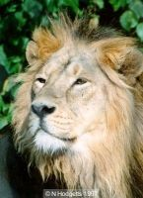
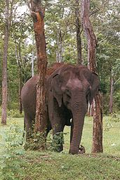
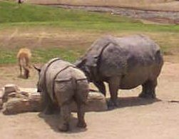
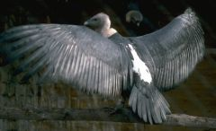
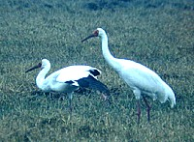
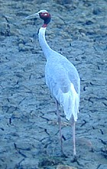
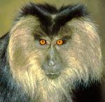
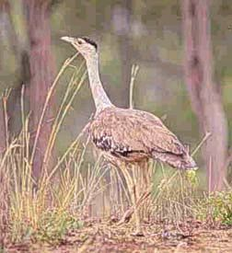
Endangered Indian Wildlife

Slide 38
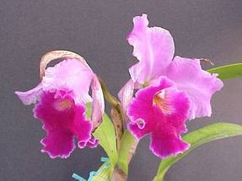
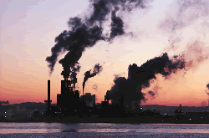
Biodiversity loss
Habitat Degradation
All Natural habitats are under threat from human activities
Over-exploitation, deforestation, reclamation, mining, roads, dams, Pollution,
Habitat fragmentation
Wildlife corridors destruction
If current trends continue, humanity will irreversibly alter virtually all of Earth's remaining natural ecosystems within a few decades.

Slide 39


Slide 40

Biodiversity loss
Introduced Species/ Alien spp
-Lantana, Mikenia invasion in Western Ghats
-Rabbit boom Doom story in Australia
Overexploitation of plants and animals
-Frog legs from India exported to Europe and North America- Now it is banned
Global climate change
-Loss of diversity due to extreme climatic conditions

Slide 41

Global warming & Biodiversity
1700 plants, animals and insects species moved pole wards at an average rate about 4 miles per decade in the last half of the 20th Century.
Mass death of Coral reefs because of coral
bleaching World wide
Islands in Sunderban sinking,
Threat to Bengal Tiger

Slide 42


Over the past 25 years, penguin populations have shrunk by 33 percent in parts of Antarctica, due to declines in winter sea-ice habitat.
According to a new global study 90 percent of all large fishes have disappeared from the world's oceans in the past half century.
The Golden toad (Bufo periglenes) and the Harlequin frog (Atelopus varius) of Costa Rica have disappeared as a direct result of global warming

Slide 43

Human-Animal Conflicts
Examples
Leopard at Sanjay Gandhi National Park, Borivili
our interference with the wildlife habitats
Crop raiding by elephants
Destruction of Wildlife Corridors
Bharatpur (Keoladeo National Park)
Wrong conservation decisions avoiding people
Sariska -Tiger

Slide 44



Hunting/ Poaching
Trade in tiger bone, skin
Major factor that threatens survival
Used for thousands of years in Asian medicine for treatment of rheumatism
Ivory trade
Decimated Indian Elephant populations and skewed sex ratio
Tiger bone wine

Slide 45


Slide 46

Tradition of Conservation
Animal worship
Snake, Peacock, Eagle, Rat, Cow
Sacred groves
Vat Vruksha Pooja, Vana Mahotsava
Sacred flowers, leaves etc for Pooja
Bishnoy Community
Known to lay down lives for plants/wildlife
Budhism and Gandhism & Universal Brotherhood concepts
Emperor Ashoka established Animal Hospitals in 3rd Century BC

Slide 47
Conservation Myth
“Nature conservation is Against development ?”
Truth
Ultimately no development is sustainable without taking care of Nature,
On the other hand people participation is vital
Sustainable Development
“Meeting the needs of the present without compromising the ability of future generations to meet their own needs”*
*

Slide 48
Conservation Efforts: International
The Biodiversity Convention
Focuses on the conservation of biodiversity and on sustainable use of biological resources and equitable sharing of benefits arising from their use. 1992 at United Nations Conference on Environment and Development held in Brazil
The Convention on wetlands of International importance
The Convention also known as the Ramsar Convention, was signed in Ramsar (Iran). It provides a framework for international cooperation for the conservation of wetland habitats.

Slide 49
International Convention
World Heritage Convention 1972: biodiversity has to be seen as global heritage
Convention on International Trade in Endangered species of Wild flora and fauna India 1977
Bonn Convention on conservation of Migratory species. India 1979

Slide 50
National Conservation strategies
Indian Forest Act 1927
Environmental Protection Act 1986
Forest Conservation act 1980
Fisheries act 1897, 1984
Wildlife protection act 1972 Amendment 1991
Biodiversity Act 2002
Maritime Zones Act

Slide 51
Conservation efforts
Chipko movement,
Silent valley was saved due to Environmentalist (Kerala shastra sahitya parishad) movement
What if Pooyamkutty hydroelectric project in Kerala comes?
-Submergence of 2400 ha of forest
-174 sp of medicinal plants- loss
-Loss of breeding ground of Elephants

Slide 52
Protected areas (In-situ Conservation)
National Parks 102
Wildlife Sanctuaries 515
Community Reserves 4
Conservation Reserves 47
Tiger Reserves (41 sanctuaries & NPs)
Elephant Reserves (25 ERs)
Ramsar Sites (25 sites)
Important Bird Areas (465 sites)
UNESCO heritage Sites (5 sites)
Biosphere Reserves (17 BR)
Project snow leopard (Himalayan states)

Slide 53
Ex-Situ conservation
Maintaining genetic germplasm in seed banks, zoos, captive breeding sites, gene banks…outside the natural habitat of the species
Botanical Gardens
Lead Garden projects
Central Zoo Authority
Lab for conservation of Endangered species, tiger, lion, black bug, vulture
Vulture Conservation Breeding Centres
Conservation of traditional farming practices, seed banks

Slide 54
SOLUTIONS
PRESERVE NATURAL CAPITAL:
Restore damaged ecosystems
Halt the loss of priority habitats
Significantly expand protected areas
PRODUCE BETTER:
Reduce inputs and waste
Manage resources sustainably
Scale-up renewable energy production

Slide 55
SOLUTIONS
CONSUME MORE WISELY:
Through low-Footprint lifestyles
Sustainable energy use
Healthier food consumption patterns
REDIRECT FINANCIAL FLOWS:
Value nature
Account for social and environmental costs
Support and reward conservation
Sustainable resource management and innovation

Slide 56
SOLUTIONS
EQUITABLE RESOURCE GOVERNANCE:
Share available resources
Make fair and ecologically informed choices
Measure success beyond GDP

Slide 57
What can we do?
Acquire and propagate knowledge on Wildlife & Biodiversity
Participate in decision making through EIAs
Respond positively to conservation efforts
Join hands with concerned organizations such as BNHS, WWF, GreenPeace etc., which are working for Nature Conservation
Visit Natural forests and Sanctuaries and feel the Nature
Respect everyone's right to live

Slide 58
What can we do?
Be Vigilant
Report to Forest authorities and/or Police of any Forest destruction, Tree cutting, Wildlife trade or hunting. Wildlife (Protection) Act, 1972 prohibits any person from hunting of Wild life and buying of Wild life products.
Avoid Wildlife products
Do not buy items made up of Ivory, Fur, leather, etc,
Also try to convince other people not to buy them either.
Minimise the use of wooden/paper materials.
Plant trees/plants /protect forests/habitats/join Nature club of you college, city

Slide 59


Slide 60





Rich bio-diversity in the Campus
Faunal bio-diversity
114 species of Birds
91 species of butterflies
21 species of mammals
17 species of reptiles

Slide 61





Amrita Prakriti Samrakshan Samiti-Activities

Slide 62






Amrita Prakriti Samrakshan Samiti-Activities

Slide 63




World Car free Day 28 Sept 2014

Slide 64

Dr Maya Mahajan
Associate Professor
Centre for Sustainable Future
Amrita University
Coimbatore 641112
Cell 09489518865
Email: maya.arun@gmail.com
SAVE NATURE FOR SUSTAINABLE FUTURE

Slide 65

Amma says……….
By protecting and preserving wild and domestic animals, trees, and plants we are protecting and preserving nature. Trees, animals, birds, plants, forests, mountains, lakes and rivers- everything that exits in nature-are in desperate need of our kindness, compassionate care and protection.
There is an inseparable bond between man and nature. For man, there cannot be an existence removed from nature.

